Slide 1


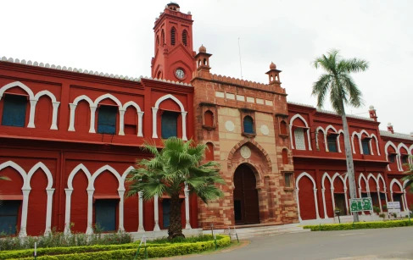


ANNUAL MAGAZINE
ALIGARH MUSLIM UIVERSITY
2023-24

